Slide 1


Lorenzo Pieri
Greta is not happy with your website, and she’s right.

Slide 2

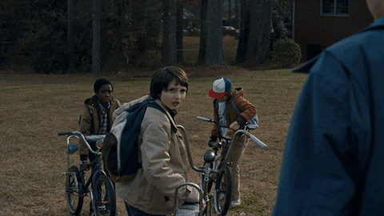
It’s just a website, right? :)
Well, turns out it’s not.
Your website is one of the beautiful snowflakes that is part of a bigger picture.
Let’s go find out why!

Slide 3



Hello Codemotion 🫶
My name is Lorenzo Pieri and I’ll have the pleasure to take you on this environtechnical journey :) I’m Senior Software Engineer @ Antidote Technologies Inc. and you can find me online as
404answernotfound
404answnotfound

Slide 4
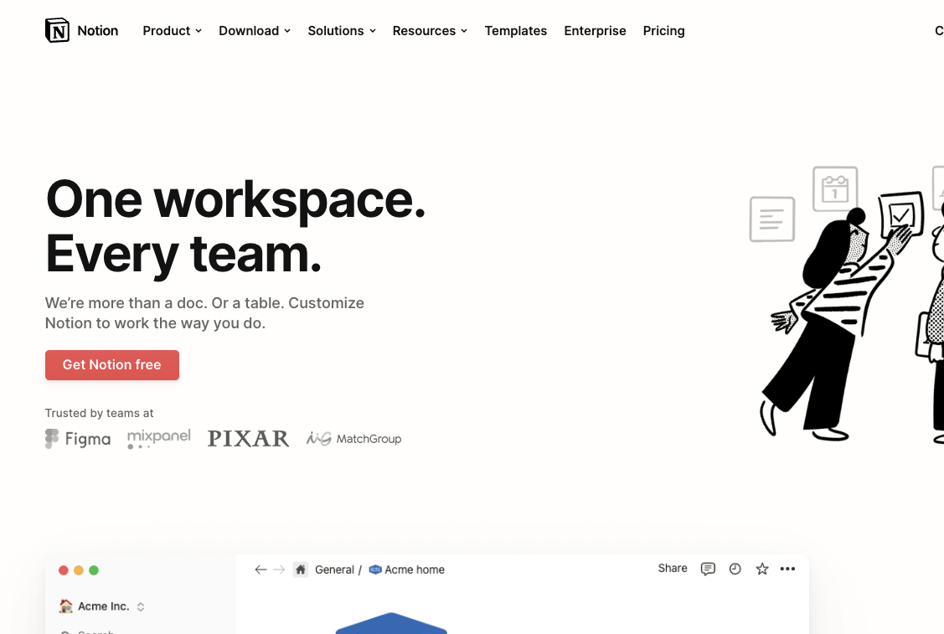

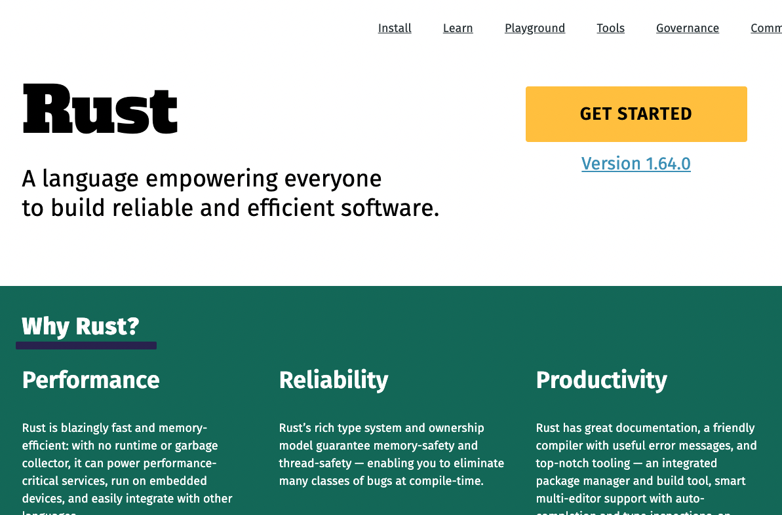
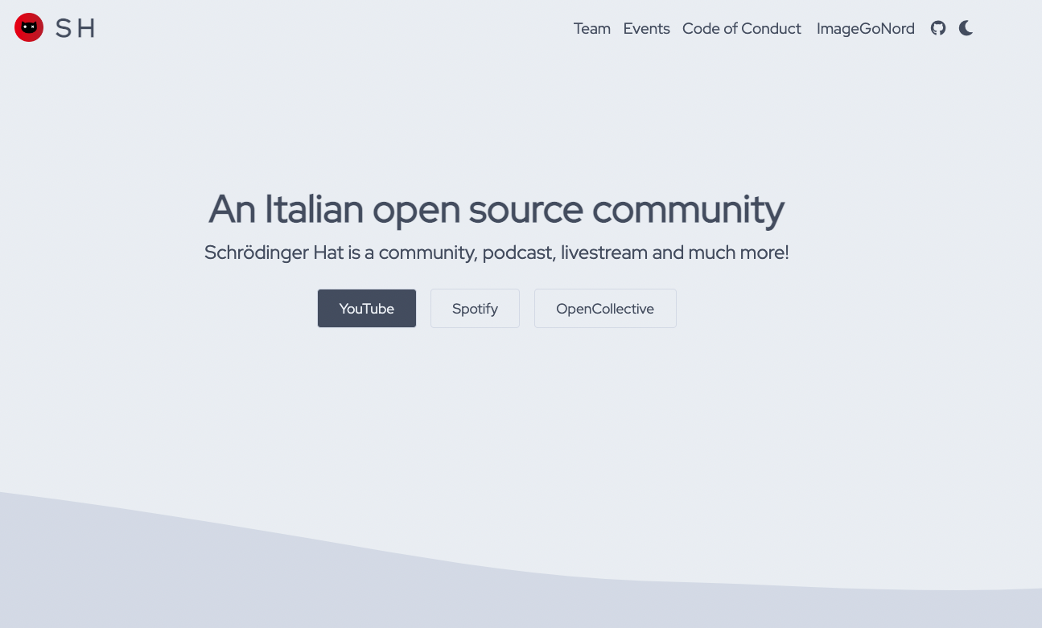
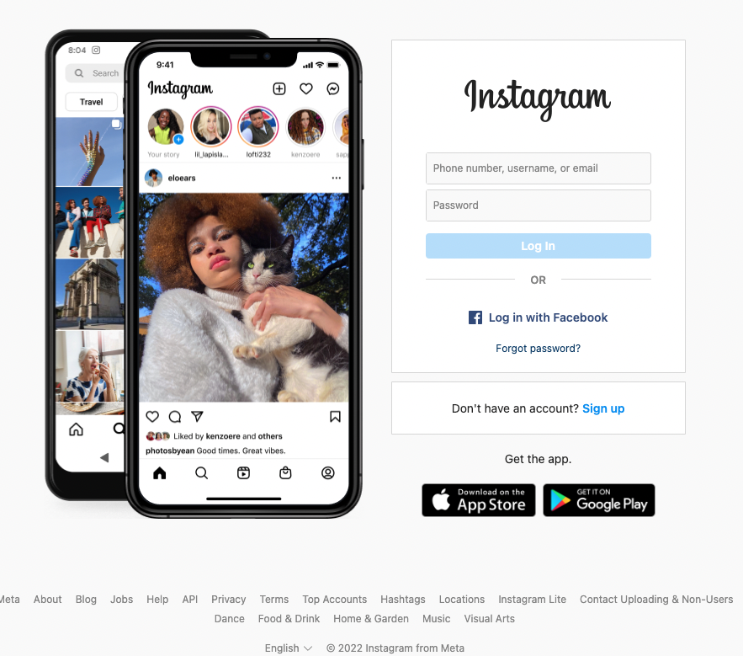
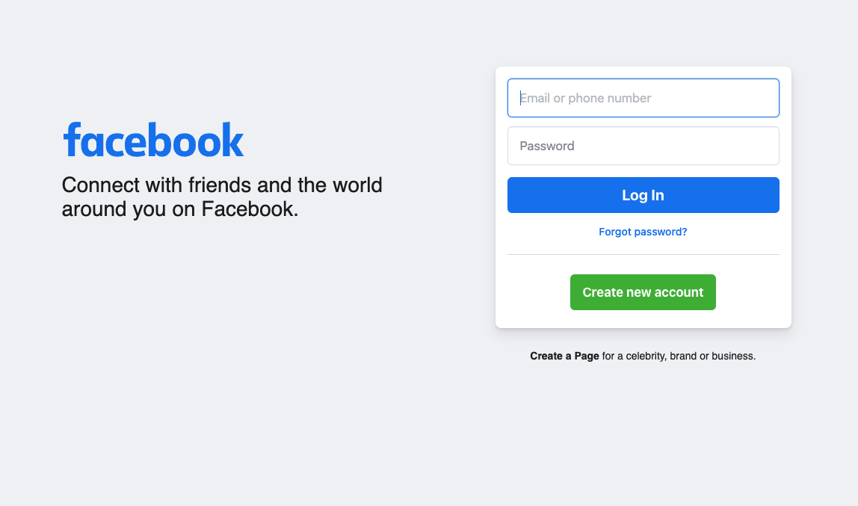

Let’s start small
Are websites and webapps that much environtechnically eco unfriendly?
Recent research points out to the elephant in the room. We are not taking care of it as we should.

Slide 5

Some numbers
4 billion+ people use internet every day ¹
up to 4% greenhouse emissions to double by 2025 ¹
3rd on the podium for electricity demand ¹
X3 internet traffic in less than a decade ¹
1% global electricity use just in data centers ¹
356% growth in webpage weight ²
196% growth in internet speed ³
https://www.climateimpact.com/news-insights/insights/infographic-carbon-footprint-internet/
https://almanac.httparchive.org/en/2021/page-weight
https://www.ookla.com/articles/world-internet-speeds-july-2021

Slide 6
Websitemania⁴
404answernotfound.eu
my personal/technical blog
36kg (80 pounds) CO2 produced per year based on 120,000 page views
-81% CO2 emitted compared to other websites
Same as 127 km (78 miles) traveled on an airplane
Same as 272 km (170 miles) traveled by car
306kb total page size
58ms time to first byte
4. Carbon footprint metrics measured with https://karmametrix.com/ and https://www.trycarbonapi.com/
5. Performance metrics measured with https://gtmetrix.com/

Slide 7
Websitemania⁴
twitter.com
our beloved social platform
206kg (450 pounds) CO2 produced per year based on 120,000 page views
+8% CO2 emitted compared to other websites
Same as 723 km (450 miles) traveled on an airplane
Same as 1550 km (963 miles) traveled by car
1.9MB total page size
419ms time to first byte
4. Carbon footprint metrics measured with https://karmametrix.com/ and https://www.trycarbonapi.com/
5. Performance metrics measured with https://gtmetrix.com/

Slide 8
Websitemania⁴
fridaysforfuture.org
an important mission
316kg (700 pounds) CO2 produced per year based on 120,000 page views
+65% CO2 emitted compared to other websites
Same as 1109 km (700 miles) traveled on an airplane
Same as 2377 km (1470 miles) traveled by car
3.17MB total page size
760ms time to first byte
4. Carbon footprint metrics measured with https://karmametrix.com/ and https://www.trycarbonapi.com/
5. Performance metrics measured with https://gtmetrix.com/

Slide 9
How to check our tech footprint
Websites like karmametrix.com can help you find the values we read just a bit before
There’s an API for measuring your carbon footprint! trycarbonapi.com
If you care about performance gtmetrix.com is useful to measure your websites metrics
And of course, an NPM package for your apps, because why not.
npmjs.com/package/carbon-footprint
Environmental friendliness is a win/win. You get better metrics and SEO, the environment feels better :)

Slide 10

It’s not about better
Different websites require different assets. A private blog, as performant as it can be, is still a text wall most of the times.
Let’s not compare for judgement but rather learn an important lesson. We can all participate in this cultural shift.
Let’s start :)

Slide 11

Let’s change the world
One byte at a time
Dark themes are not just cooler (c’mon), they also allow to save energy and cut on consumption. Dimming a little the light on our monitors also doesn’t hurt!
Most newer frameworks allow for easy theming and addition of light/dark themes so that could be a first simple implementation

Slide 12
Let’s change the world
Javascript is the infamous Damocles’ sword
A thoughtful bundle size can go a long way
Responsive images and diverse formats
Variable fonts
Cache, cache, cache
Edge computing
Special mention
Async communication

Slide 13
Bundle size matters
You don’t really need the entire Lodash fam
Are you minifying your files?
What about gzipping?
Tree-shaking?!
Lots of this is done directly by module bundlers but they are as good as we configure them!
6. When smaller is better (https://dunhamweb.com/blog/when-smaller-is-better)
7. Read the tea leaves (https://nolanlawson.com/2021/02/23/javascript-performance-beyond-bundle-size/)
Notes:
https://nolanlawson.com/2021/02/23/javascript-performance-beyond-bundle-size/

Slide 14
Bundle size matters
The power of compounding
You might think that 20kb of deleted unused code from your lib won’t matter that much. Think again. That’s what happened with the plugin Mailchimp for Wordpress.
1kb in a file that is being loaded on 1 million websites reduces CO₂ emissions by an estimated 1475 kg per month. Now do that times 20. For one library.
8. Mailchimp for Wordpress carbon footprint (https://dannyvankooten.com/website-carbon-emissions/)
9 Evaluating consumption for mobile data transfer (https://www.mdpi.com/2071-1050/10/7/2494)
Notes:
https://nolanlawson.com/2021/02/23/javascript-performance-beyond-bundle-size/
https://dannyvankooten.com/website-carbon-emissions/

Slide 15
Bundle size matters
Use the tools, Luke!
Tools like Bundlephobia and Webpack Bundle Analyzer can help you better understand how your app is served to the users :)
Rollup or esbuild users? No problem, the internet got you covered!
Notes:
https://nolanlawson.com/2021/02/23/javascript-performance-beyond-bundle-size/
https://dannyvankooten.com/website-carbon-emissions/

Slide 16
Images can be smaller
8K profile pictures are kind of too much, aren’t they?
I’m not saying that good quality images are bad, just that we should be more caring about size and load times, for many reasons:
performance (load times)
user experience
SEO metrics
bandwidth usage
carbon footprint! That’s pretty much the entire CTA!

Slide 17
Images can be smaller
Responsive images are the new black
There are amazing services for optimization and image responsiveness.
Just like the Image tag in `nextjs`, you can use images through these services.
A few names:
cloudinary
imgix
akamai

Slide 18
Images can be smaller
Responsive images are the new black
Images make up for +20% weight on webpages and considering we are mostly visual learners, this is increasing!
Remember that srcset is your friend and that thumbnails should have smaller images :)
Also, webp caniuse is 94% as of this moment. Unless you need to support IE11, just go for webp.
10. Optimize your images for the web (https://kinsta.com/blog/optimize-images-for-web/)

Slide 19
Variable fonts
Thin 200 is cool, but are you using it?
95% global usage if you don’t need to support IE. Just drop IE unless you strictly need it.
@fontface can also help you support older browsers in case you need a different set of fonts :)

Slide 20
Cache
Do you have a minute to talk about our lord, CDN?
There is no magic wand for carbon footprint, but there are nice and handy things that we can do to significantly enhance performance, SEO scores and drop our website and webapp carbon footprint
CDNs and caches in general can revolutionize your environtech game
11. Climate and Cloudflare (https://blog.cloudflare.com/the-climate-and-cloudflare/)

Slide 21
Edge Computing
Your friendly neighborhood servers
Edge Computing is the best environtechnical choice you can make.
Serve content as close to your users and win in speed, performance and again, carbon footprint!
This could reduce latency and power consumption by 60%
12. The environmental case for edge computing (https://impakter.com/the-environmental-case-for-edge-computing/)
13. On global electricity usage of ICT trends (https://www.researchgate.net/publication/275653947_On_Global_Electricity_Usage_of_Communication_Technology_Trends_to_2030)

Slide 22
🍪 Async Communication
Not everything needs to happen in sync. Libuv your professional life!
The last cookie. We live in an ever connected world of real time data and communication, FOMO and urgency. Let’s drop this.
Not only will our minds be in a better and more relaxed place but we will also become considerably more aware of time, space and value.

Slide 23
(Not su much) fun numbers
The real expense
17g, median carbon footprint for each email written in corporate jargon
1.1kg, median carbon footprint for a zoom meeting with 2 people in 1h
+1000kg, carbon footprint/year if you own 2 computers and a screen
+200kg, carbon footprint/year for a 19” monitor
Notes:
https://www.cibotechnologies.com/blog/calculating-the-carbon-footprint-of-zoom-meetings/

Slide 24
What can I do
It’s the little things
Dim your monitor!
Turn off the computer if you don’t need it :)
Sure, jargon is cool but less CO2 is better. Less emails and zoom calls can save the planet!
Less time on your phone
Read a little more about it! Plenty of small things to help the planet
Notes:
https://www.cibotechnologies.com/blog/calculating-the-carbon-footprint-of-zoom-meetings/

Slide 25
Resources
There are so many nice resources and encouraging ones to share that one slide wouldn’t be enough!
So I bought a domain
https://environtechnical.eu
I will share all the resources I found on the subject and keep it updated with more researches and great articles on the subject! Bookmark it for later use :)

Slide 26
Shout out!
Environmental issues are all over the news, almost every single day but I didn’t realize how much the Internet is a big part of it until I read my good friend Amilkare’s blog
https://amilkare.it/siti-web-sostenibili/
Go and have a read! It’s a great article :)

Slide 27


Contacts
Let’s keep in touch
Open Source Community
Schrodinger’s Hat - Join us :)
https://404answernotfound.eu
https://www.schrodinger-hat.it
Github 404answernotfound
Twitter @404answnotfound

Slide 28

Thank you!
Have a great Codemotion experience

